Slide 1

Personal Area Networks
Department of CSE, IUT

Slide 2
IEEE 802.15 Personal Area Networks (PAN)
Protocols for Wireless Personal Area Networks (PANs)
Usually short-range (small area) wireless networks
Devices usually owned by a person or family
Portable and Mobile devices like PCs
Personal Digital Assistants (PDAs)
Peripherals (Mouse, Keyboard, etc.)
Cell Phones and Pagers (or Beepers)
Consumer Electronic Devices (TVs, Players, etc.)
The first project approved in 2002 was IEEE 802.15.1 (Bluetooth)

Slide 3

IEEE 802.15 Personal Area Networks (PAN)^{[1]}
Bluetooth uses the same frequency bands as IEEE 802.11 (WLAN)
IEEE 802.15.2 (2003) targeted their coexistence
IEEE 802.15.3 targeted low cost and low power with higher data rate
IEEE 802.15.3a provided even more data rates
IEEE 802.15.4 (2003) had very low cost and used very low power, but had lower data rates compared to 802.15.1
Each of the standards have different PHY and MAC layer specifications
All the PAN standards are meant for a range of 10 m approx.

Slide 4
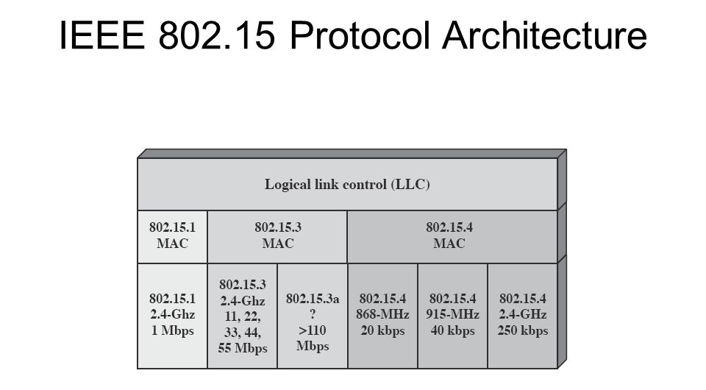

Slide 5
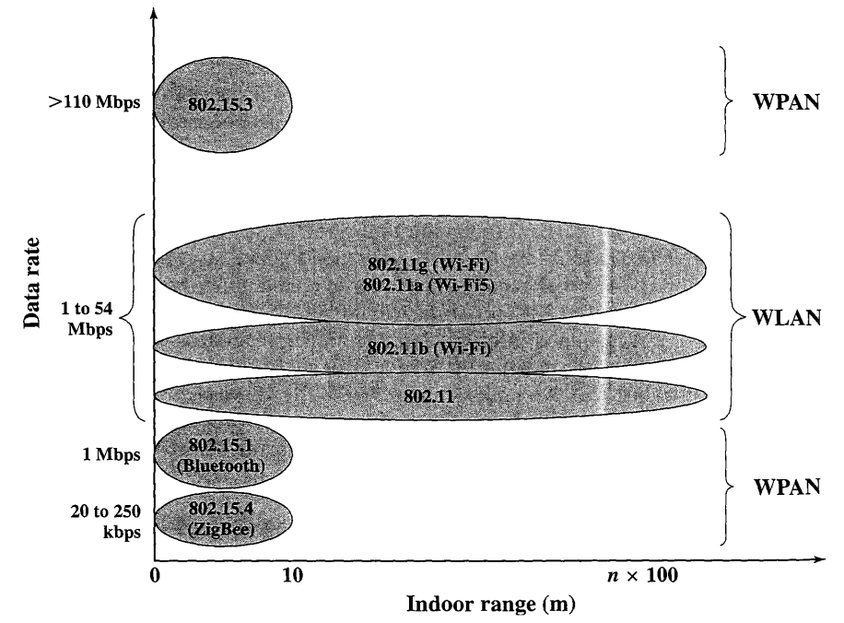
Wireless Local Networks Comparison

Slide 6
Overview of IEEE 802.15.3
Relatively higher data rates
Example Connections:
Digital Still Cameras <-> Printers/Kiosks
Laptop <-> Projector
PDA <-> Camera/Printer
Speakers (surround-sound) <-> Receiver
CD/MP3 Player <-> Headphone/Speaker
Mobile/Smartphones <-> Headphone/Speaker
Video Camera <-> Television
The applications are mainly in consumer electronics

Slide 7
Overview of IEEE 802.15.3
Characteristics of IEEE 802.15.3 applications:
Short range (10 m)
High Throughput (Greater than 20 Mbps)
Low Power Usage (Can be battery-powered)
Low Cost (Reasonable for Consumers)
QoS can be provided
Dynamic (piconet architecture)
Simple connectivity
Privacy (Encryption)
The requirements/characteristics differ from Local Area Networks (LAN) or IEEE 802.11

Slide 8
IEEE 802.15.3 MAC
Formed of devices called DEVs
One DEV acts as a coordinator
The piconet coordinator (PNC) assigns time slots
PNC communicates with all DEVs
Difference between AP and PNC
Access Point (AP) relays MAC frames
PNC determines the time slots for communication
PNC does not relay messages
QoS is maintained through TDMA along with guaranteed time slots (GTS)

Slide 9
Overview of IEEE 802.15.3a
Provides higher speed (110 Mbps or greater)
Intended to address video streams and multimedia
During the time of the book, this protocol was in progress
Currently, more protocols have emerged:
IEEE 802.15.3b (2005) improves implementation and interoperability of MAC and includes many optimizations, corrections, etc.
IEEE 802.15.3c (2009) even higher data rates using millimeter-wave-based alternative physical layer (PHY) – 3.8 to 5.3 Gbit/s
More Information is available but not required for this course^{[2]}.

Slide 10

Overview of IEEE 802.15.4
Relatively lower data rates
PHY layer has direct sequence spread spectrum
868 MHz/915 MHz – 20-40 kbps
2.4 GHz – 250 kbps
Very low power (battery life – multiple months to years)
Very low complexity (easy to produce and setup)
Different versions were employed as follows
IEEE 802.15.4a, 4b, …. up to 4g (2012) ^{[2]}
IEEE 802.15.4g works with RFID

Slide 11
IEEE 802.15 Protocols/Networks
IEEE 802.15.5 Mesh Networking
IEEE 802.15.6 Body Area Networks
IEEE 802.15.7 Visible Light Communication (VLC)
Free-Space Optical Communication (FSO)
Not the same as fiber-optical cables
IEEE 802.15.8 Peer Aware Communications (draft under dev.)
IEEE 802.15.9 Key Management Protocol (draft in practice)
IEEE 802.15.10 Layer 2 Routing (draft in practice)
IEEE 802.15 Wireless Next Generation Standing Committee (SCwng)

Slide 12
IEEE 802.15.5 Mesh Networking
No hierarchy and self-configuring
Can form Mesh topologies
There is no fixed standard
Different vendors with different devices
Did not agree on a common standard
Uses protocols like OSLR (Optimized Link State Routing Protocol)
Used in wireless ad hoc networks
We will see more in MANET
OSPF (Open Shortest Path First) is an example of Link-state routing

Slide 13
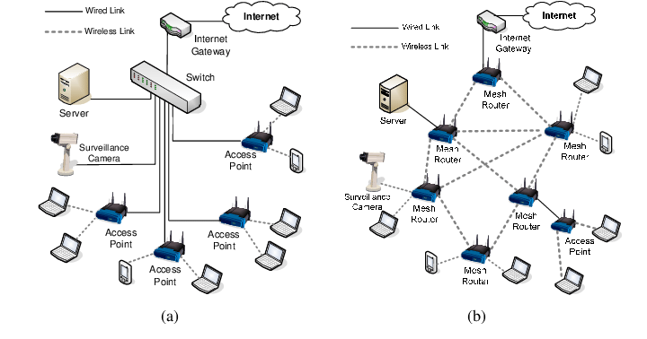
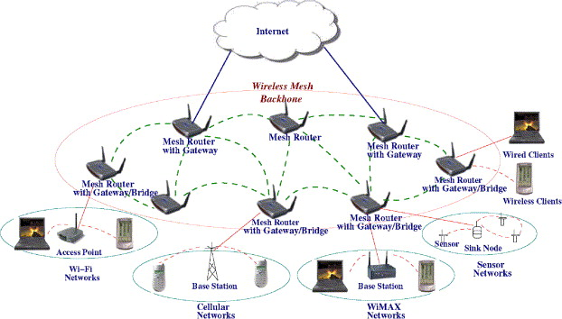
Example Mesh Networks
Mesh Networks can form core backbones
It can extend to different types of Networks
Can replace wired networks to reduce the wiring or increase connectivity

Slide 14
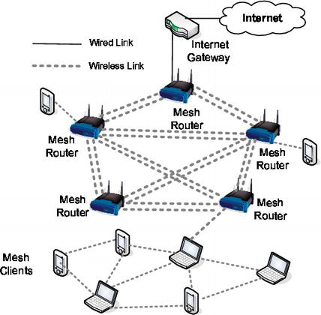
Mesh Networks with both Edge and Core Devices

Slide 15
Advantages and Disadvantages
Routes are known through routing tables with no discovery delay
Routing overhead is greater but not exponential
Can include or discard nodes at will
Can connect to different types of networks
Cannot check link quality (only presence)
Wastes energy on unused routes (proactive)
Cannot be used for WSN
Requires large amount of bandwidth

Slide 16
REFERENCES
[1] Wireless Communications and Networking – 2nd Edition, William Stallings, 2005
[2] https://en.wikipedia.org/wiki/IEEE_802.15

